Slide 1
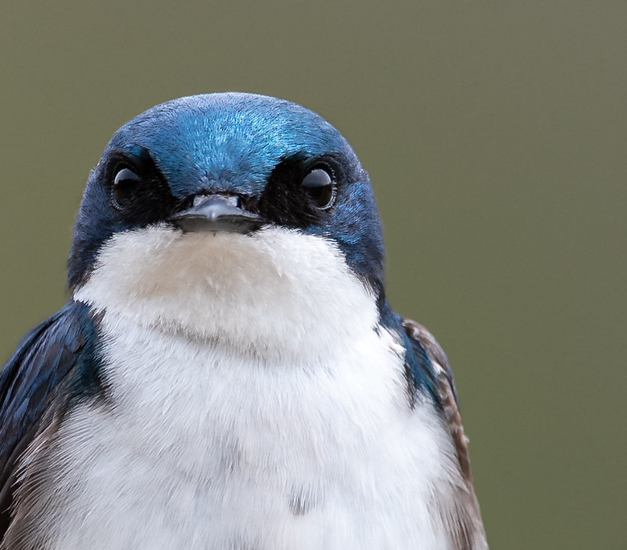
EMERGE
Could a New Set of Values Help Restore Our Right Relationship With Earth and Its Living Communities?

Slide 2
We believe Quakers are already equipped to dismantle the drivers of our climate and biodiversity crises.
How do we become a catalyst for a cultural shift?

Slide 3
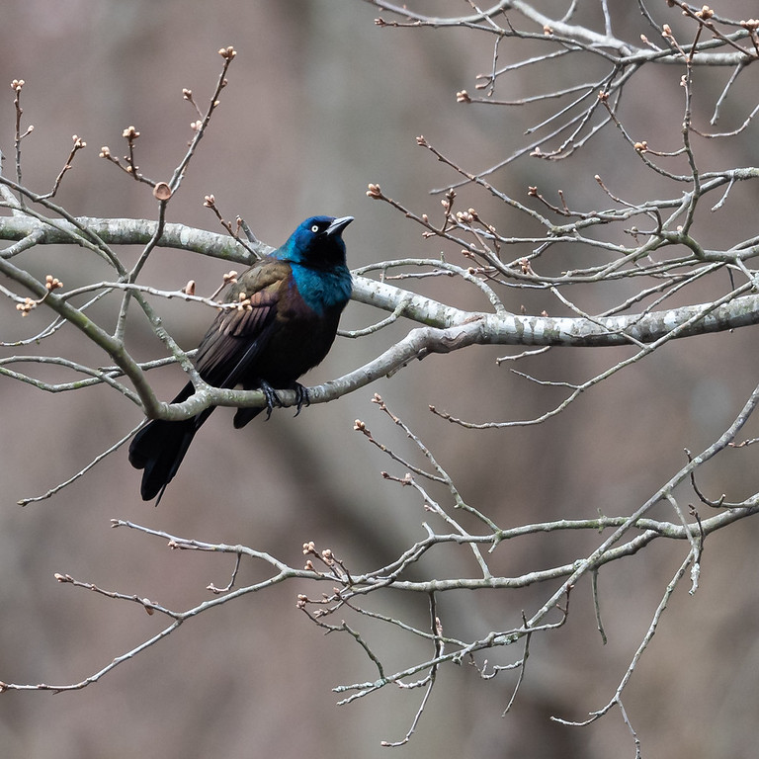
EMERGE…
In the tradition of the familiar acronym SPICES,
Guides transformation, from our current state to a new way of living…

Slide 4
As we take each letter and progress…
From Empathy, Mindfulness, and Ecological Integrity…
To Right Action, Growth, and finally, Endurance…

Slide 5
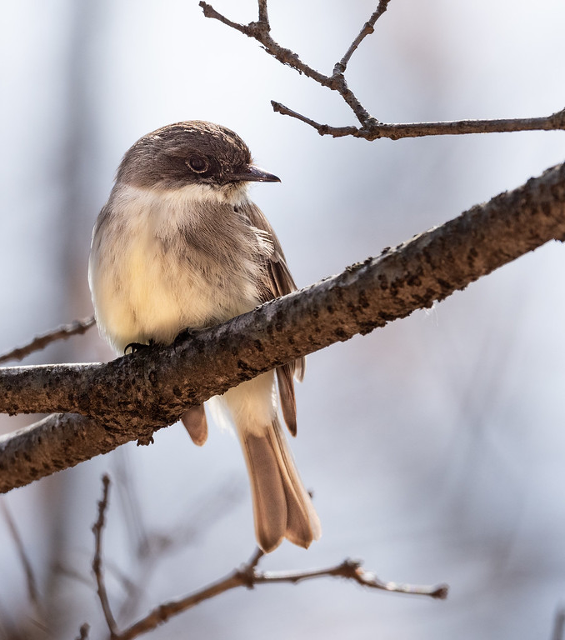
With empathy, we perceive other living communities and feel an emotional stake in their thriving.
Empathy lets us reimagine the place of humans in the world.
EMPATHY

Slide 6
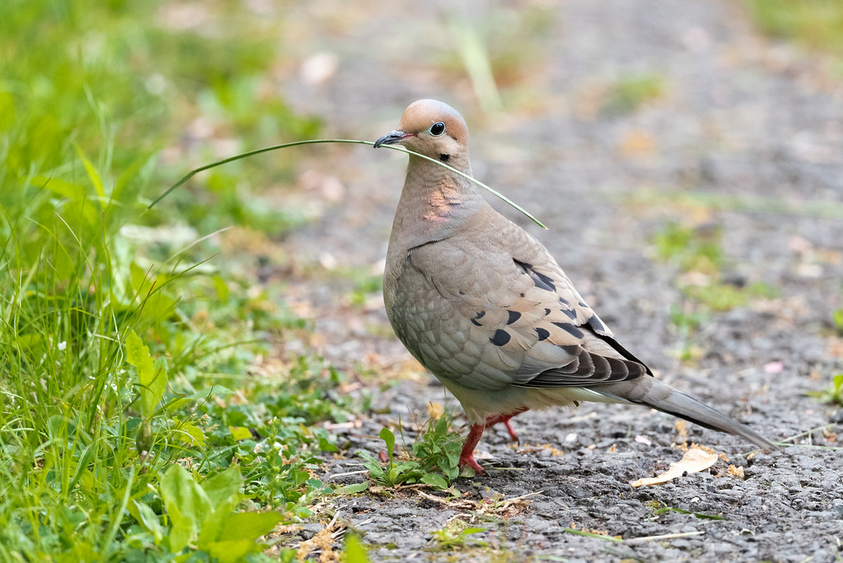
Could we become essential workers
on our planet?

Slide 7
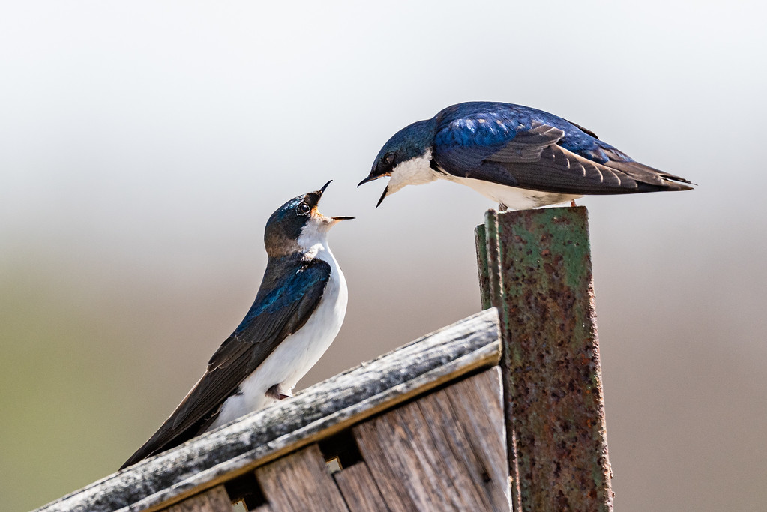
“One and all.”
Spirit, all-encompassing!

Slide 8
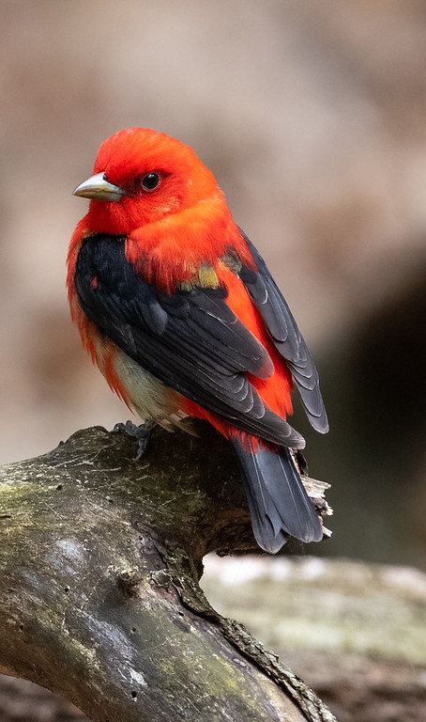
MINDFULNESS
is attention at a deeper level.
Where what we discern isn’t just knowledge, but a connection to an
inner call to act.

Slide 9
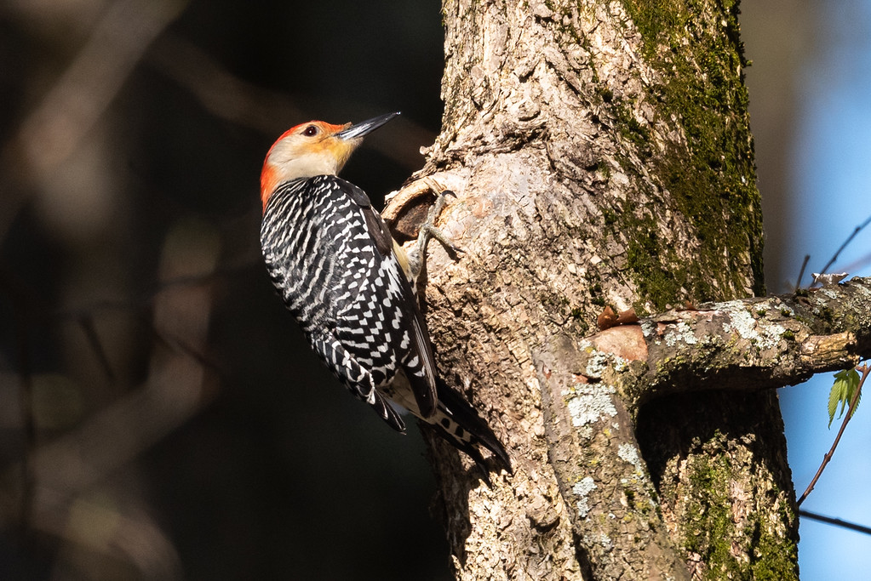
Just as no one lives apart from air, water, the winds…
No one lives apart from human-driven ecological crises.
What happens to one living community happens to all.

Slide 10
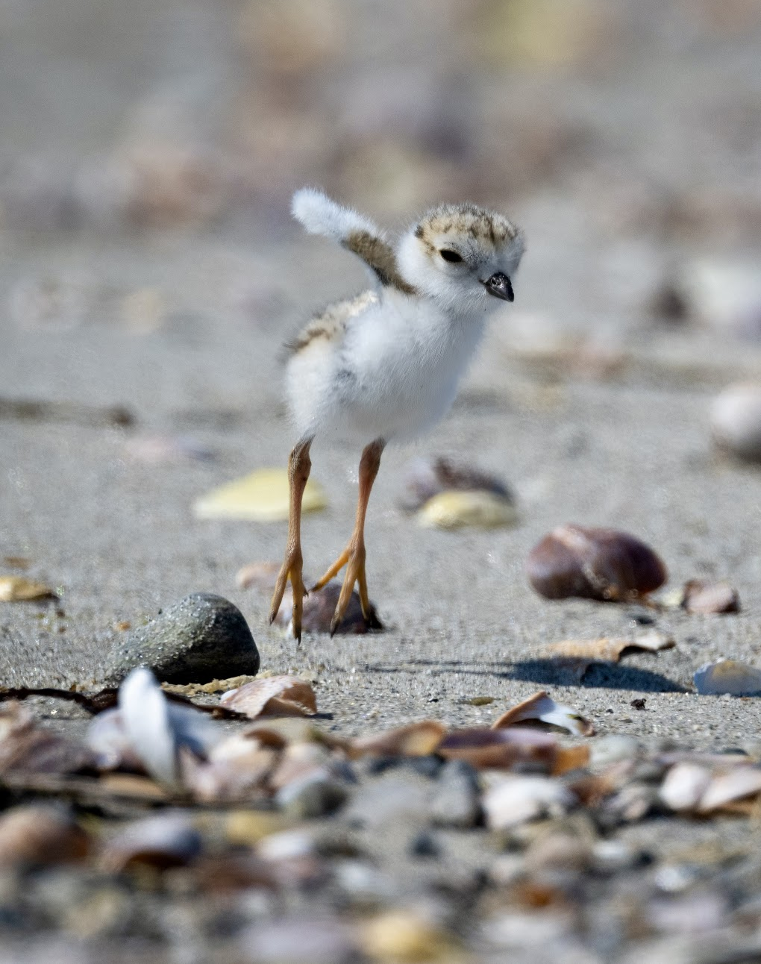
ECOLOGICAL INTEGRITY…
Integrating our spiritual journey with the unfolding of Earth’s systems and communities as far as possible – as we are led.

Slide 11
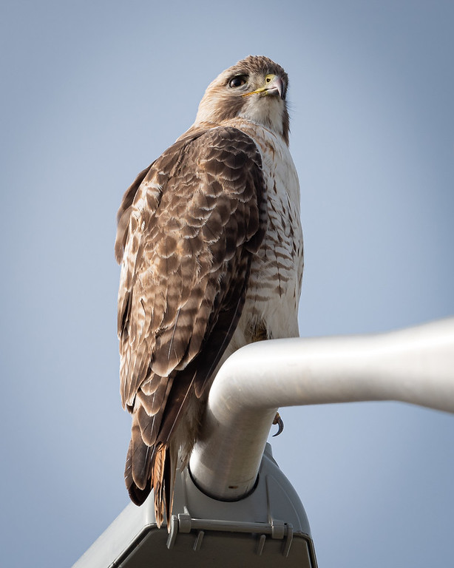
To discern right action we follow the
testimony of simplicity, striving to live within our ethical means on a finite planet.
RIGHT ACTION

Slide 12
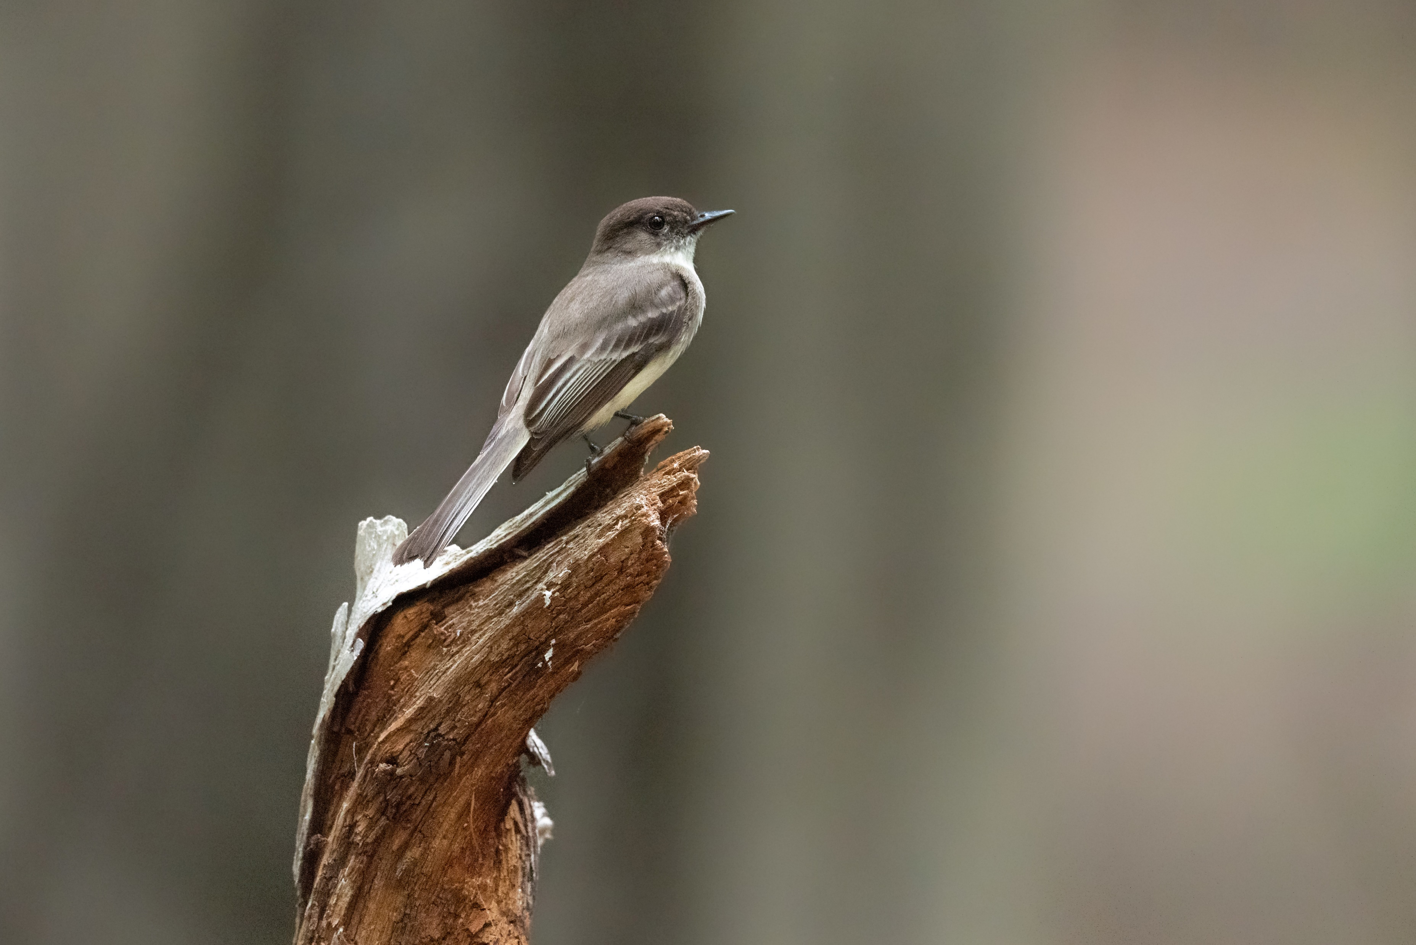
The life-saving results could happen relatively quickly, for we’ll be siding with
the power of nature.

Slide 13
A popular word in economic circles, but our focus is on spiritual growth.
GROWTH…

Slide 14
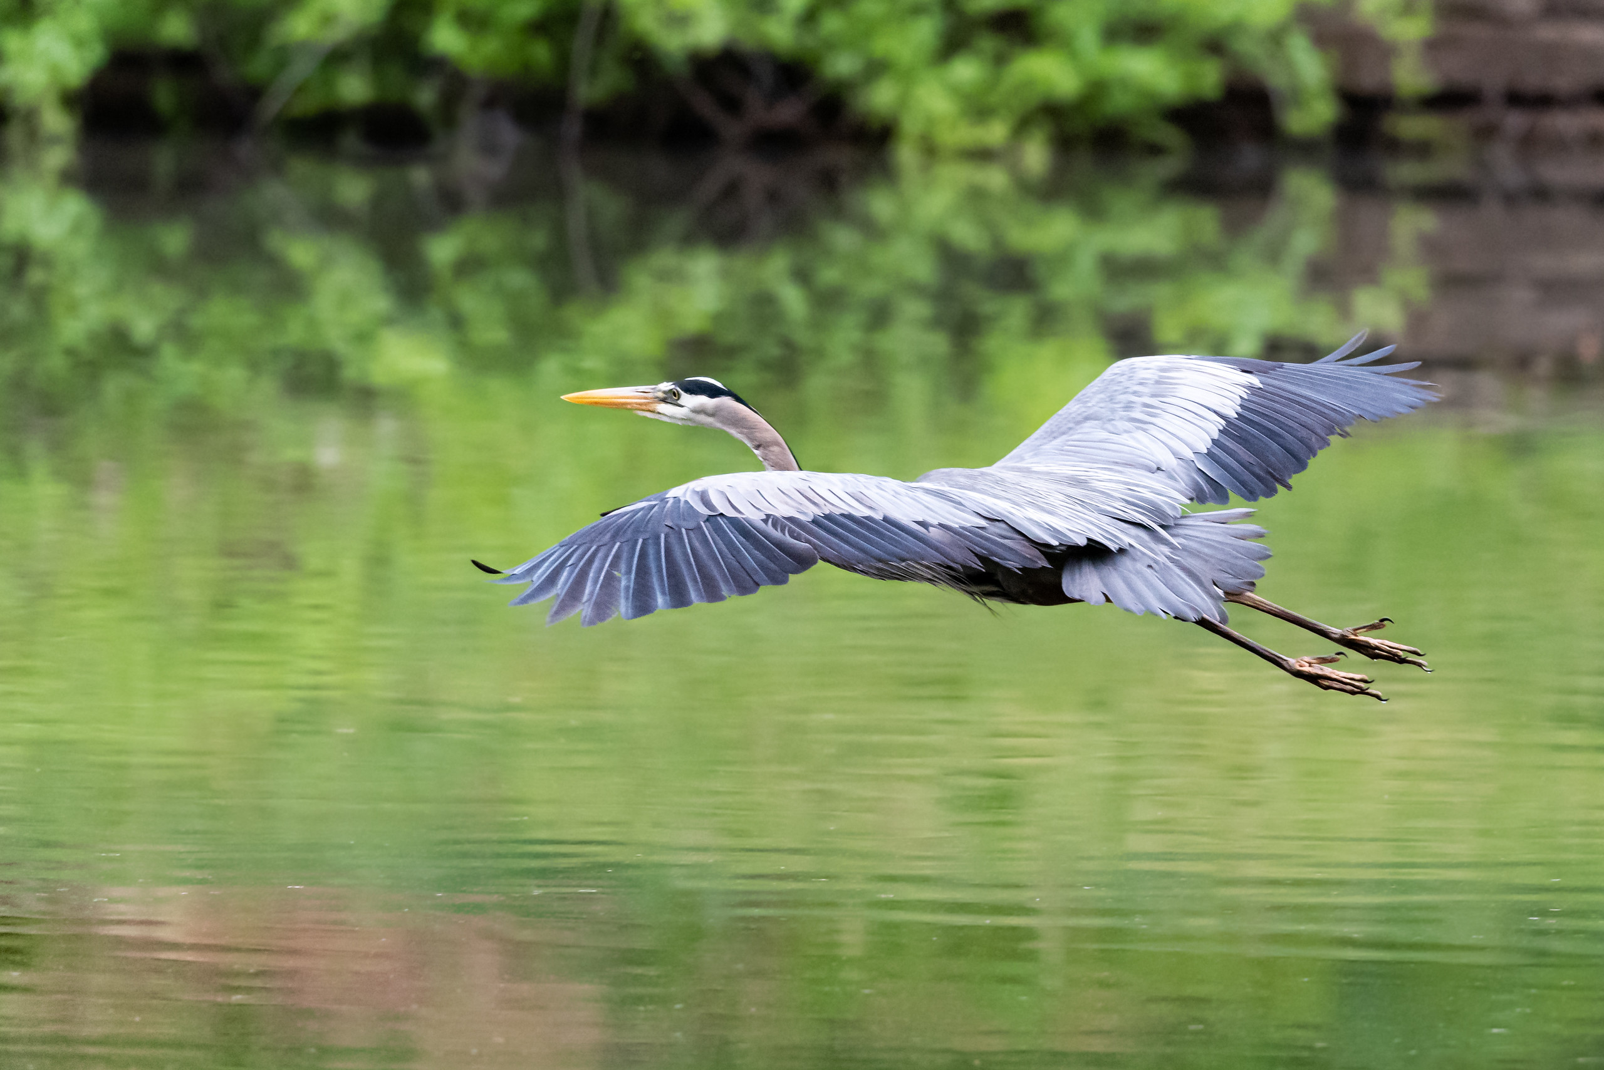
Through spiritual growth we free ourselves to define affluence by its true meaning: a flow.

Slide 15
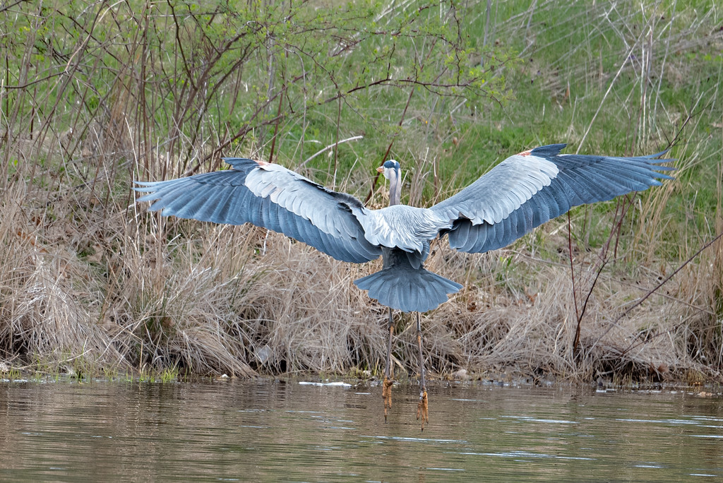
Imagine EMERGEnce…
From crisis into committed love for our planet,
For its systems…its precious life.

Slide 16
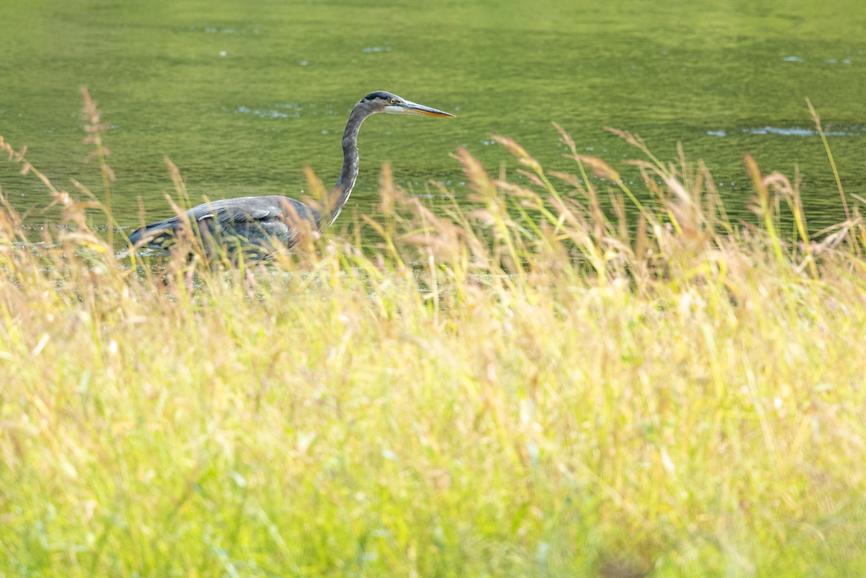
The EMERGE values speak when we are not able to,
or when we feel like letting it go.

Slide 17
Reimagining our place
in the universe is vital
to human progress.
We take courage, knowing Quakers are uniquely positioned…
Free to sit with religious texts, to engage with them, to consider continuing revelation.

Slide 18
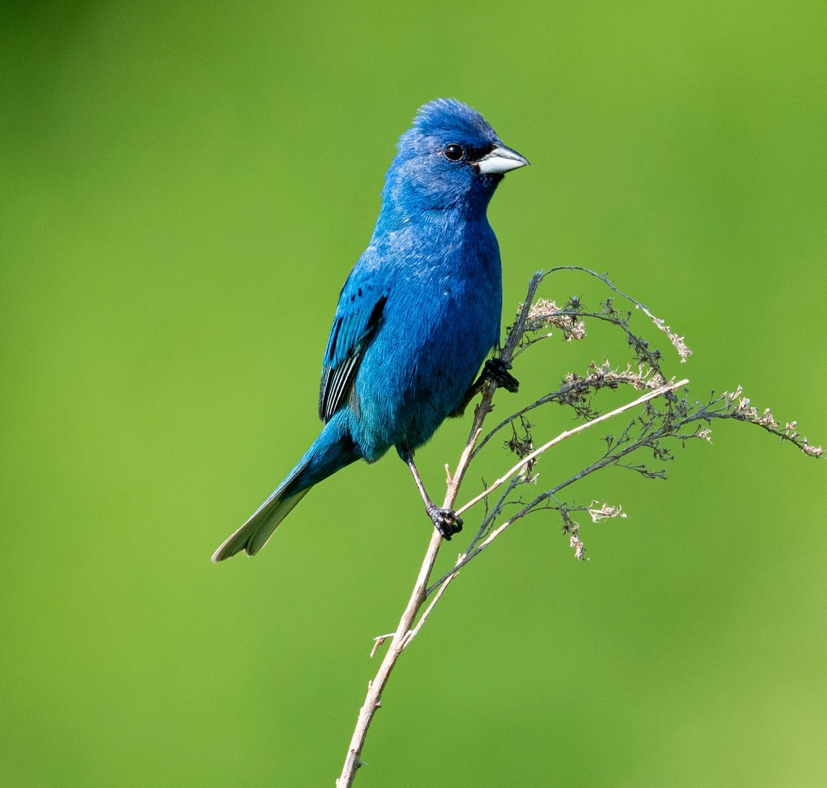
ENDURANCE
Real progress depends upon deep work, advocacy, and dialogue that plumbs our values, causing an evolution of consciousness that transforms the way we perceive our world and our role in it. This is a lifelong task.

Slide 19
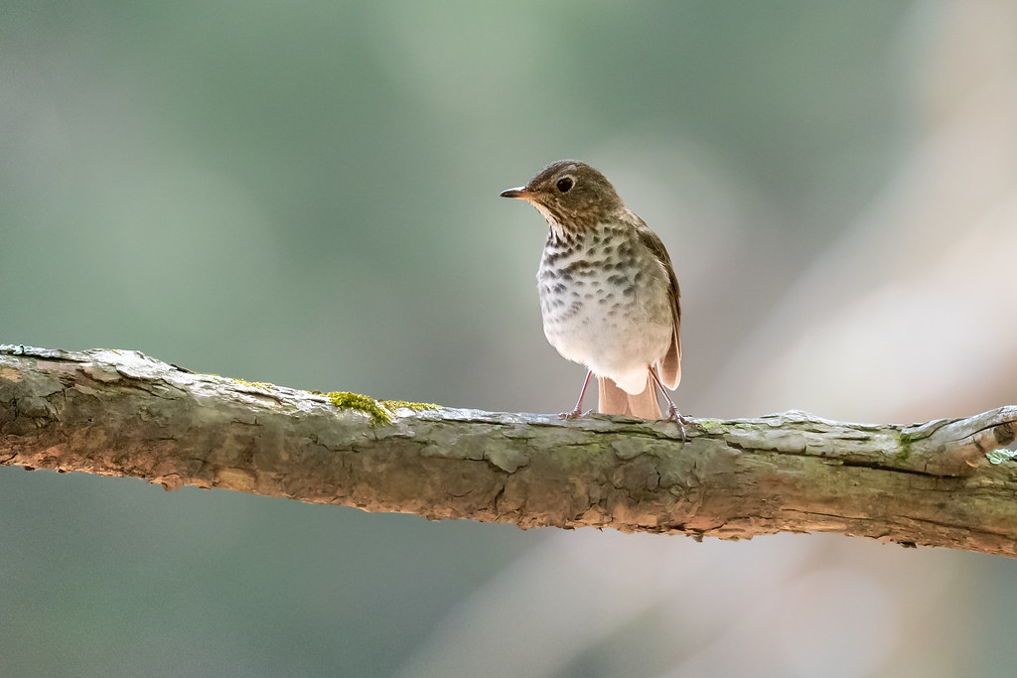
Imagine…

Slide 20
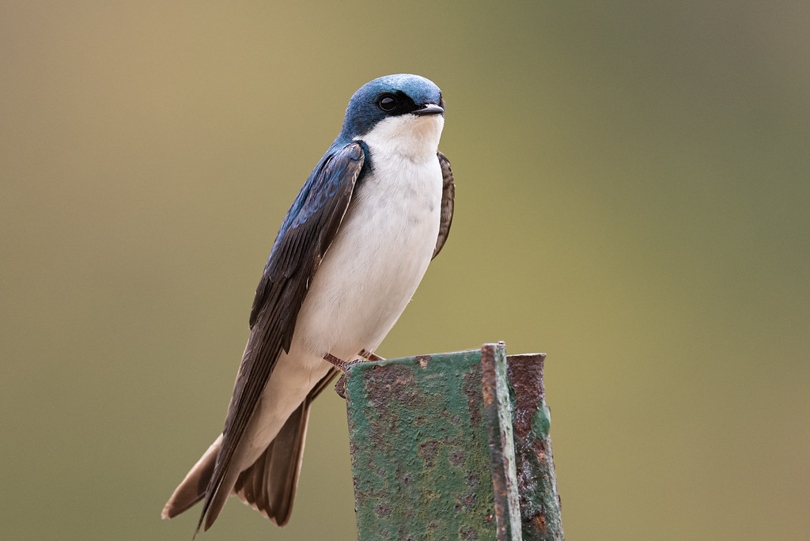
…an Earth restored.

Slide 21
EMERGE is a touchstone.
It guides inquiry in our own hearts,
in each other,
and together.

Slide 22
Production:
Radnor Meeting
Climate Action Committee and Friends
Photography:
Michael Zager

